Slide 1
TRADE: SOFTWARE DEVELOPMENT MODULE CODE:SWDVC301 LEVEL 3 SOFTWARE DEVELOPMENT A ,B & C
Module name: CONDUCT VERSION CONTROL
TRAINER:AZAN ABIZEYIMANA

Slide 2
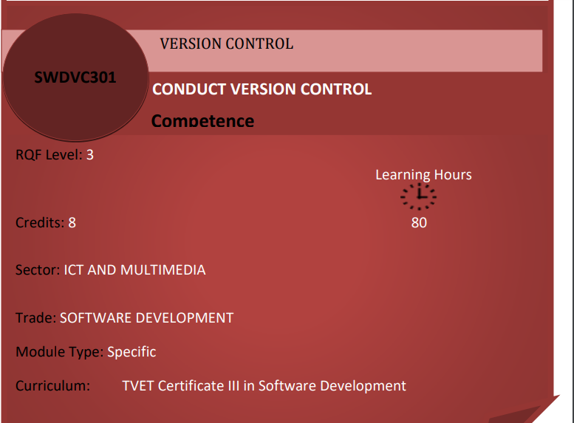

Slide 3
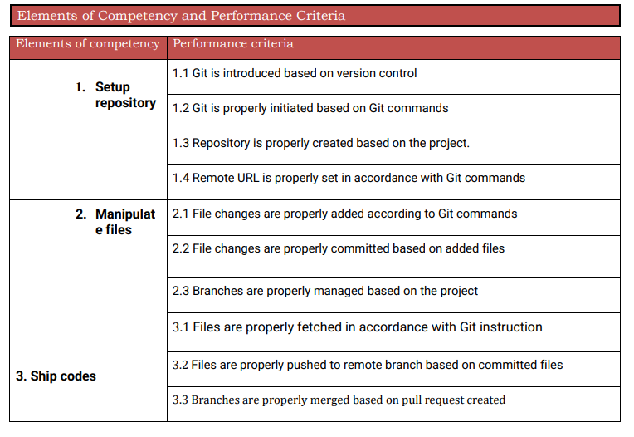

Slide 4
Introduction
Let's imagine a company operating in many countries with many employees, in order to work they need to come to work in different departments. What happened during the COVID 19 pandemic? Are employees still working as usual? We all know it's not possible, because many companies were forced to close their doors because of the stay-at-home order. How would the company's employees continue to work and be aware of the changes in their company? How would they know about the changes in their institution? How would they keep up with the past?

Slide 5
There are different problems that may be raised, among them we can cite the followings:
Lack of collaboration
Storing versions
Restoring previous version once needed
Figuring out what happened in different branches
Problem of backup
In summary Is the reason why we need a version control system as developers in order to overcome those cited issues.

Slide 6
Learning outcome 1: Setup repository Indicative content 1.1: Definition of general key terms
Version control, also known as source control, is the practice of tracking and managing changes to software codes.
Version control systems are software tools that help software teams manage changes to source code over time.
As development environments have accelerated, version control systems help software teams work faster and smarter.

Slide 7
Before we dive into setting up version control, let me explain some common terms and commands used in version control so you understand what everything means!
Repo, short for Repository: it’s a storage space where you project or code resides in, it’s like a folder for your code!
There are two types of repos, local and remote.
1. Local Repo:
it is going to be on the machine (laptop or computer) where your code is stored at. Locally storing it means only you have access to the code and if your computer crashes or you lose that code, then it would be pretty hard to get it back.

Slide 8
2. Remote Repo:
it is going to be hosted on a website, like GitHub,
for example, and your code here is accessible to not just you, but your whole team!
If you lose your code on your computer, your code is still safe on here!
This is a kind to iCloud storage.

Slide 9
Git Commands When Working with Local Repositories
git init: This Git command converts a directory into an empty repository. This is the initial step you need to take to build a repository. Once you run git init, you will be able to add and commit files and directories.
git add: This command allows you to add files in the Git staging area. The file must be added to the index of Git before being available to commit to any particular repository. You can use this command to add directories, files, etc.
git commit: The commit command in Git allows you to track the changes in the files in a local repository. Each commit has its own unique ID for reference.
git status: The git status command returns the present state of a repository, like if the file is in the staging area but has not been committed.

Slide 10
Cont’
git config: There are numerous configurations and settings possible in Git, and this command allows you to assign these settings. User.name and user.email are the two significant settings that set the name and email address of a user.
git branch: This command determines the branch of the local repository and allows you to add or delete a branch.
git checkout: You can use this command to switch to another branch.
git merge: The merge command allows you to integrate two or more branches together. It combines the changes made in the branches.

Slide 11
Git Commands When Working with Remote Repositories
1.git remote: This Git command allows you to connect a remote repository to a local repository.
2.git clone: You can use the clone command to create a local copy of an already existing remote repository. This allows you to copy and download the required repository to the system. It is similar to the init command while working with remote repositories as it allows you to build a local directory, consisting of all the necessary files and history of the repository.
3.git pull: The pull command is used to run the latest version of any repository. This pulls all the changes made from the remote to the local repository.
4.git push: This command sends local commits to the respective remote repository. It needs two parameters, i.e., the remote repository and the specific branch where it needs to be pushed.

Slide 12
Git: stands for Global information Tracker A distributed version control system that enables tracking of changes in source code and collaboration among multiple developers.
Git is used to tracking changes in the source code, enabling multiple developers to work together on non-linear development.
Before diving deep, let’s explain a scenario before Git:
Developers used to submit their codes to the central server without having copies of their own
Any changes made to the source code were unknown to the other developers
There was no communication between any of the developers

Slide 13
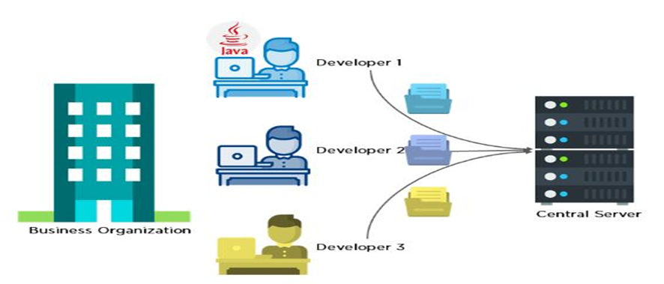

Slide 14
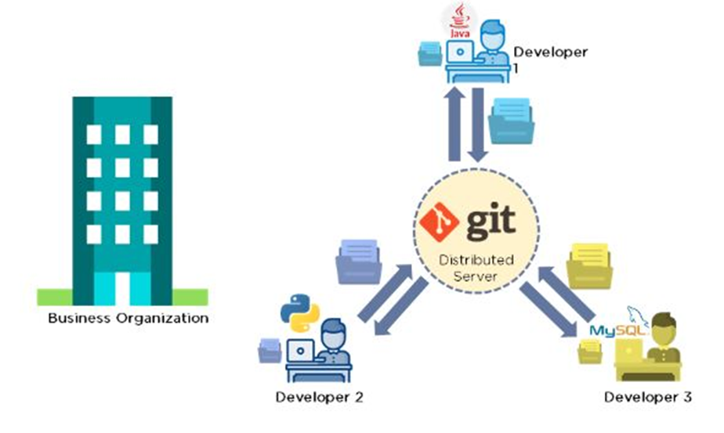
Now let’s look at the scenario after Git:
Every developer has an entire copy of the code on their local systems
Any changes made to the source code can be tracked by others
There is regular communication between the developers

Slide 15
Features of Git
Tracks history
Free and open source
Supports non-linear development
Creates backups
Scalable
Supports collaboration
Branching is easier
Distributed development

Slide 16
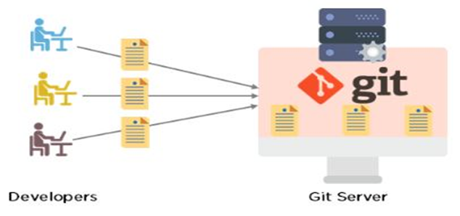

Slide 17
GitHub: is a code hosting platform for version control and collaboration. It lets you and others work together on projects from anywhere.
At a high level, GitHub is a website and cloud-based service that helps developers store and manage their code, as well as track and control changes to their code. To understand exactly what GitHub is, you need to know two connected principles:
Version control
Git

Slide 18
Terminal :A command-line interface used to interact with an operating system and execute commands, including Git commands.

Slide 19
Why the terminal?
The Terminal is a great tool for communication - and by that, I don’t mean for chatting with your best friend, but rather to access the internal CPU and other networks and computers. In coding, it is used primarily for:
Installing specific packages, updates, export and import your work to platforms like GitHub
Code testing
Error display
In short, it is a perfect way to be able to find information, manage installations and communicate with external services.

Slide 20
The End
Thank you for your kind attention

